Slide 1
Lab 2 – Intro to DS, Distance & Similarity
CS 506

Slide 2
About me

Slide 3
Lab grading
Labs are worth 10% of your grade
Labs are fully attendance based
You can miss up to 3 labs and still get all 10% toward your final grade

Slide 4
Learning Objectives
Understand cosine similarity and Jaccard similarity
Understand properties of Minkowski distance with varying p
Implement cosine similarity, Jaccard similarity, and Minkowski distance in Python
Identify when to use Jaccard similarity vs. L1-norm
Identify when to use cosine similarity vs. L2-norm

Slide 5
Data
Facts and statistics collected for reference or analysis

Slide 6
Data
Facts and statistics collected for reference or analysis
Example types of data:

Slide 7
Data
Facts and statistics collected for reference or analysis
Example types of data:
Records: m – dimensional points or vectors

Slide 8
Data
Facts and statistics collected for reference or analysis
Example types of data:
Records: m – dimensional points or vectors
E.g., (name, age, height (in)) → X = (Lucy, 11, 53), Y = (Stacy, 17, 62)

Slide 9
Data
Facts and statistics collected for reference or analysis
Example types of data:
Records: m – dimensional points or vectors
E.g., (name, age, height (in)) → X = (Lucy, 11, 53), Y = (Stacy, 17, 62)
Height
Stacy
Lucy
Age

Slide 10
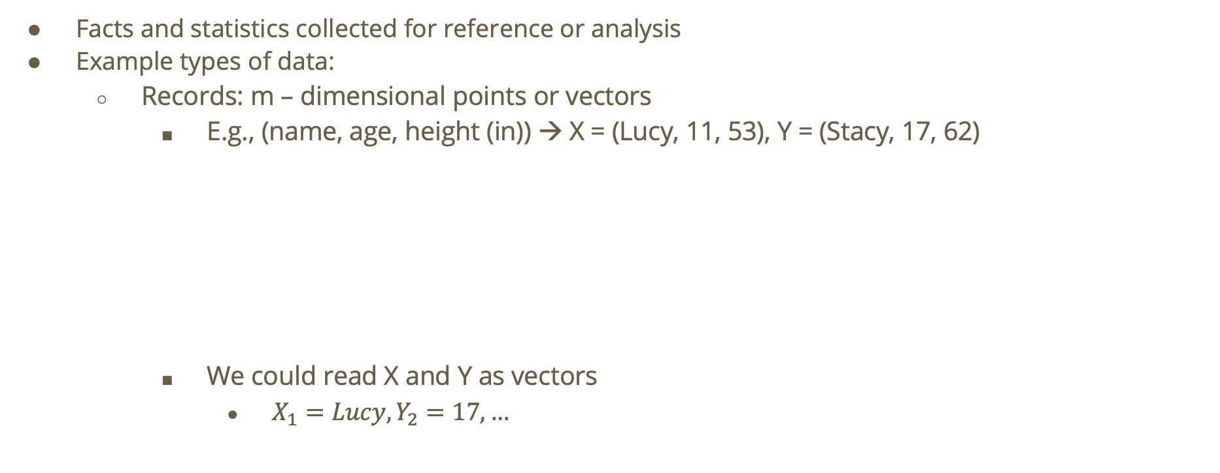
Data
Facts and statistics collected for reference or analysis
Example types of data:
Records: m – dimensional points or vectors
E.g., (name, age, height (in)) → X = (Lucy, 11, 53), Y = (Stacy, 17, 62)
We could read X and Y as vectors
$X_{1}=Lucy,Y_{2}=17,…$
Height
Stacy
Lucy
Age

Slide 11
Data (cont.)
Example types of data:
Graphs: nodes connected by edges
E.g., graph to show a social media network. Nodes = individual people, Edges = follower relation
Joe
Jill
Jared
Jack

Slide 12

Data (cont.)
Example types of data:
Graphs: nodes connected by edges
E.g., graph to show a social media network. Nodes = individual people, Edges = follower relation
Adjacency Matrix: $\left(\begin{matrix}0 & 1 & 0 & 0 \\ 0 & 0 & 1 & 0 \\ 0 & 0 & 0 & 1 \\ 1 & 0 & 1 & 0\end{matrix}\right)$
Looks like Joe and Jared follow each other!
Joe
Jill
Jared
Jack
Jill
Joe
Jack
Jared
Jack
Jill
Joe
Jared

Slide 13
Other types of data
Images
E.g., a matrix of pixels
Text
E.g., list of words
Corpus of documents

Slide 14
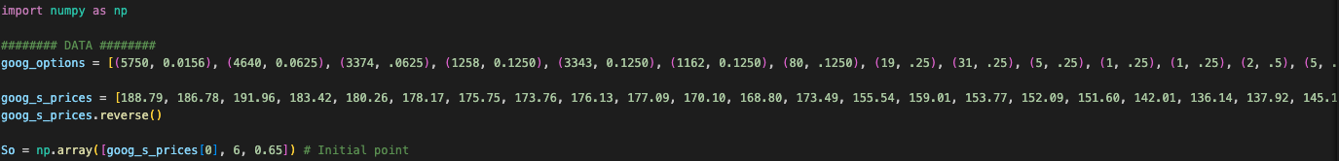
How can we represent vectors and matrices when programming?
NumPy provides fast, memory-efficient data structures and math operations for working with arrays, vectors, and matrices.
NumPy is compiled in C!
We can do vectorized math in NumPy as opposed to Python itself which would require us to use loops.
NumPy includes linear algebra functionality, statistics, and serves as the foundation for any sort of math we do in Python
E.g. image processing, machine learning, etc.

Slide 15
Recall: Learning
Learning: algorithms are trained on data (e.g., Facebook user behavior) to learn general rules or patterns, allowing them to predict future outcomes (e.g., what ads will the user most likely be interested in) or classify new data.
Supervised vs. Unsupervised Learning
Unsupervised Learning
Finding patterns in potentially unlabeled data
Goals:
find interesting structure in the data. For example, clustering algorithms!
Better understand/describe the data (possibly through data exploration and visualization)
Extract features
Fill gaps in data
Make learning algorithms faster
Get rid of noise!
Supervised learning
Learning from labeled data (e.g. our social media network assuming each profile has more dimensions)
Examples include regression, classification, support vector machines, decision trees, etc.
We could use classification to predict whether an email is spam! We could use regression for weather forecasting

Slide 16
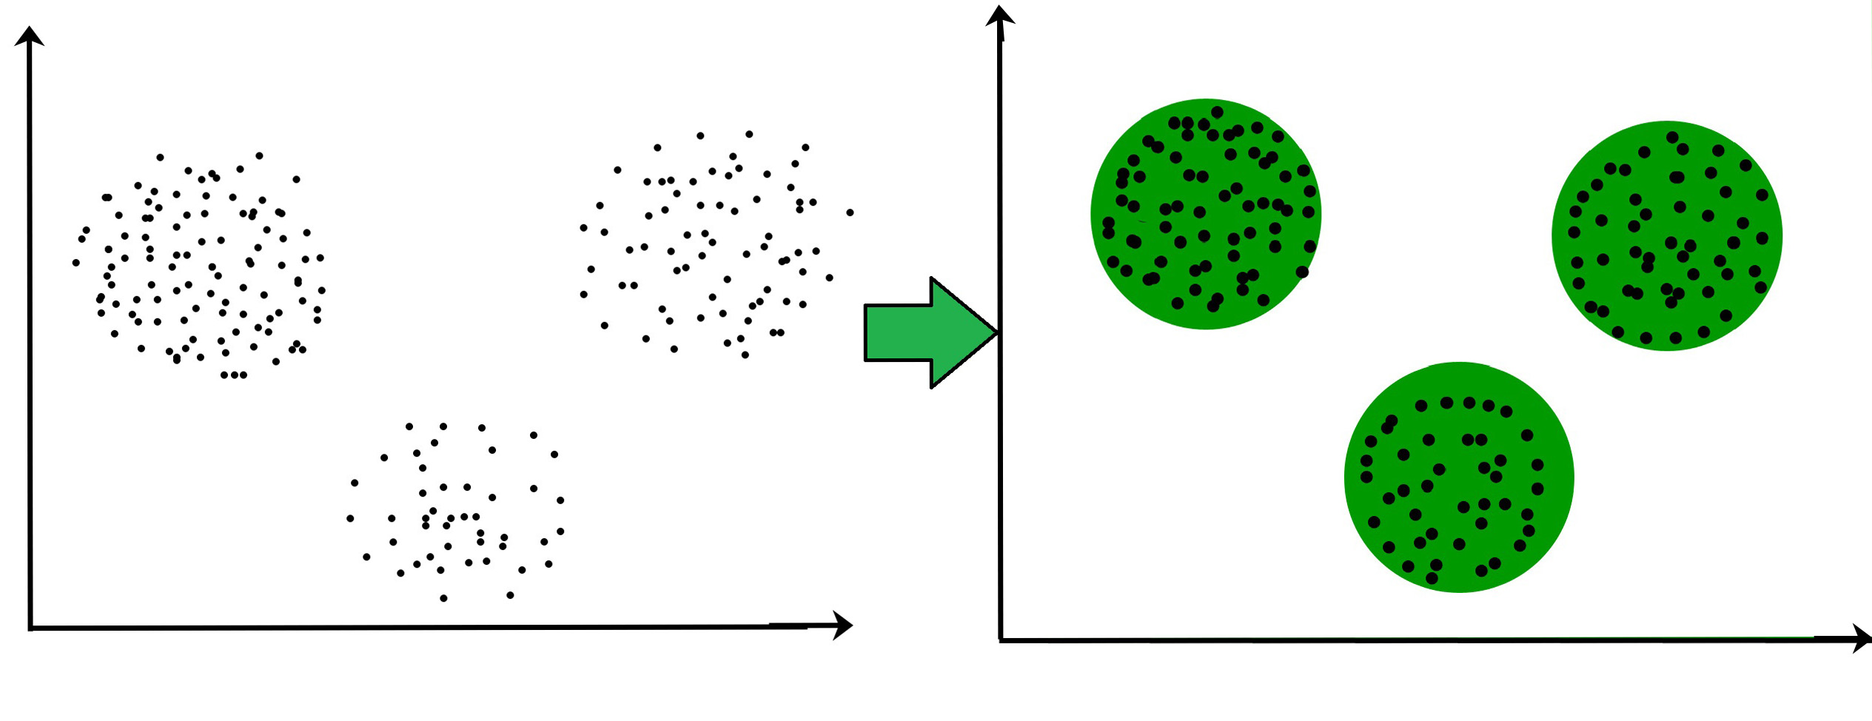
Clustering
Before clustering
After clustering
Question: at a high level, how are points grouped together?

Slide 17
Dissimilarity
Dissimilarity function takes two objects as input and returns a high value if those objects are dissimilar.
dsim(a,b) is “small” dsim(a,b) is “large”
A
A
B
B

Slide 18




Distance Functions
A type of dissimilarity function is a distance function
d is a distance function i.f.f.
$d\left(i,j\right)=0⟺i=j$
$d\left(i,j\right)=d\left(j,i\right)$
$d\left(i,j\right)≤d\left(i,k\right)+d\left(k,j\right)$ (triangle inequality)
e.g.
Euclidean distance: $d\left(i,j\right)=\sqrt{2}≤1+1$
$$j(1,1)$$
$$k(0,1)$$
$$i(0,0)$$

Slide 19

Minkowski Distance
$∀x,y∈ℝ^{d}$,
$$L_{p}\left(x,y\right)={\left(\sum_{i=1}^{d}{{\left|x_{i}–y_{i}\right|}^{p}}\right)}^{\frac{1}{p}}$$

Slide 20
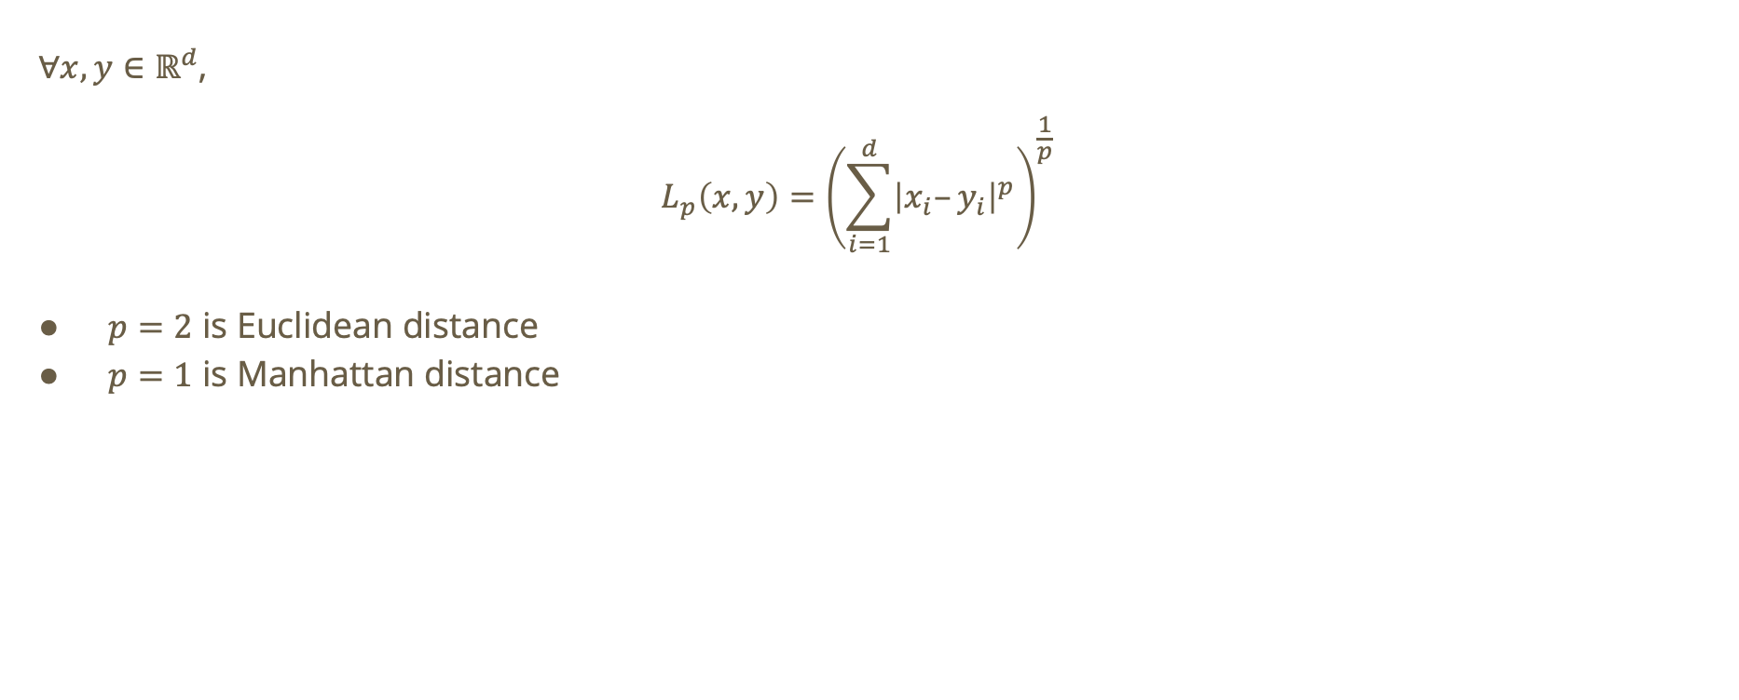
Minkowski Distance
$∀x,y∈ℝ^{d}$,
$$L_{p}\left(x,y\right)={\left(\sum_{i=1}^{d}{{\left|x_{i}–y_{i}\right|}^{p}}\right)}^{\frac{1}{p}}$$
$p=2$ is Euclidean distance
$p=1$ is Manhattan distance

Slide 21

Minkowski Distance using NumPy

Slide 22



Do not edit How to change the design
What is the Euclidean Distance between i and j?
The Slido app must be installed on every computer you’re presenting from

Slide 23





Euclidean Distance
Using formula…
$$i=\left(0,0\right),j=\left(1,1\right)$$
$$L_{2}\left(i,j\right)={\left(\sum_{i=1}^{2}{{\left|i_{i}–j_{i}\right|}^{2}}\right)}^{\frac{1}{2}}$$
$$=\sqrt{\left({\left(0−1\right)}^{2}+{\left(0−1\right)}^{2}\right)}=\sqrt{2}$$
$$j(1,1)$$
1
$$k(0,1)$$
1
$$\sqrt{2}$$
$$i(0,0)$$

Slide 24
Do not edit How to change the design
What is the manhattan distance between i and j?
The Slido app must be installed on every computer you’re presenting from

Slide 25




Manhattan Distance
Using formula…
$$i=\left(0,0\right),j=\left(1,1\right)$$
$$L_{1}\left(i,j\right)={\left(\sum_{i=1}^{2}{{\left|i_{i}–j_{i}\right|}^{1}}\right)}^{\frac{1}{1}}$$
$$=\left|0−1\right|+\left|0−1\right|=2$$
$$j(1,1)$$
1
$$k(0,1)$$
1
$$i(0,0)$$

Slide 26
Minkowski Distance for p = 1 vs. p = 2
p=1
Path length such that you can only move along axes
p=2
Straight-line displacement from one point to the other

Slide 27

Varying p
As p increases, the distance will become dominated by the largest coordinate difference
Distance becomes sensitive to largest deviation
What happens when $0<p<1$?
We can prove a violation of the triangle inequality property of distance functions
No longer a distance function!

Slide 28
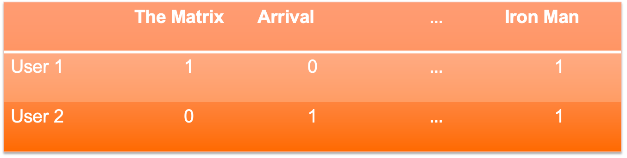
Similarity
How similar are the following users?
 | The Matrix | Arrival | $$…$$ | Iron Man
User 1 | 1 | 0 | $$…$$ | 1
User 2 | 0 | 1 | $$…$$ | 1

Slide 29

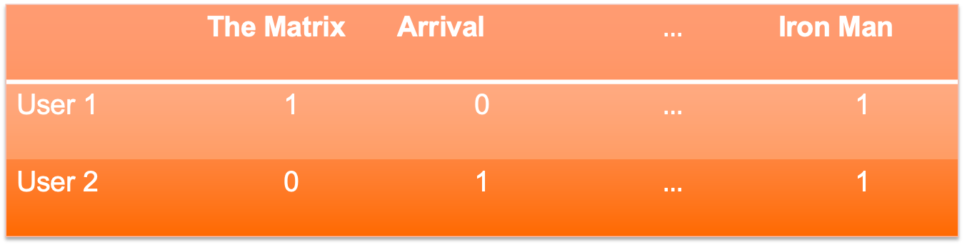
Jaccard Similarity
$JSim\left(x,y\right)=\frac{\left|x∩y\right|}{\left|x∪y\right|}$
Jaccard similarity tells us how similar the data points are. Jaccard distance will tell us how dissimilar they are:
$JDist\left(x,y\right)=1–JSim\left(x,y\right)$
 | The Matrix | Arrival | $$…$$ | Iron Man
User 1 | 1 | 0 | $$…$$ | 1
User 2 | 0 | 1 | $$…$$ | 1

Slide 30
Do not edit How to change the design
What is the jaccard similarity between user 1 and user 0?
The Slido app must be installed on every computer you’re presenting from

Slide 31

Jaccard Similarity Problem
$JSim\left(x,y\right)=\frac{\left|x∩y\right|}{\left|x∪y\right|}$
We are looking for positive occurrences so we will ignore Dune in our calculations. User 1 and user 2 have both watched Star Wars and Iron Man but only one of the users have watched The Matrix and Arrival.
$$Jsim\left(\text{User}\text{1},\text{User}\text{2}\right)=\frac{2}{4}=\frac{1}{2}$$
 | The Matrix | Arrival | Dune | Star Wars | Iron Man
User 1 | 1 | 0 | 0 | 1 | 1
User 2 | 0 | 1 | 0 | 1 | 1

Slide 32
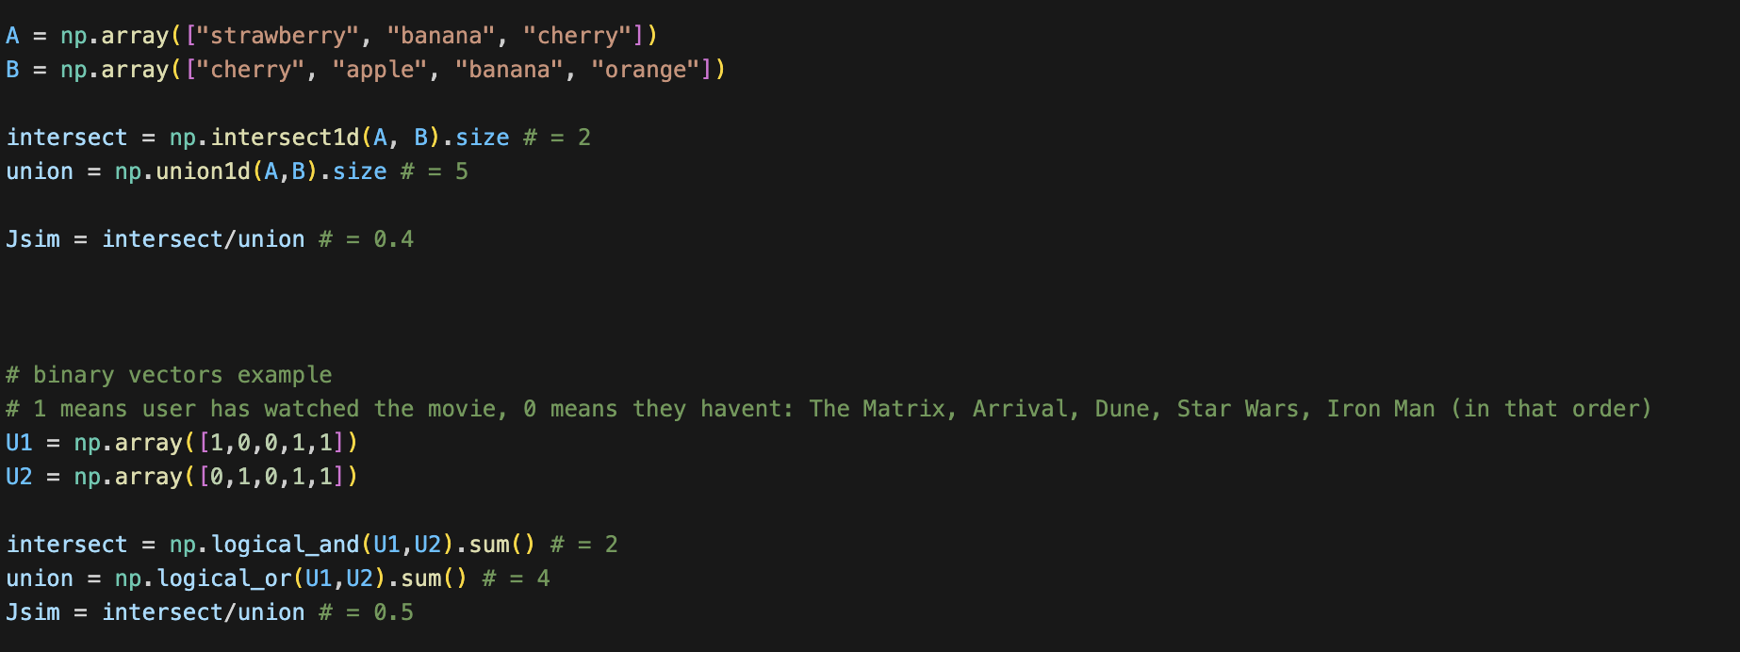
Jaccard Similarity using NumPy

Slide 33

Cosine Similarity
Similarity function takes two objects and returns a large value if the objects are similar
$s\left(x,y\right) = cos\left(θ\right)$ where $θ$ is the angle between x and y

Slide 34

Cosine Similarity
Similarity function takes two objects and returns a large value if the objects are similar
$s\left(x,y\right) = cos\left(θ\right)$ where $θ$ is the angle between x and y
If we have two proportional vectors: $s\left(x,y\right)=cos\left(0\right)=1$

Slide 35

Cosine Similarity
Similarity function takes two objects and returns a large value if the objects are similar
$s\left(x,y\right) = cos\left(θ\right)$ where $θ$ is the angle between x and y
If we have two proportional vectors: $s\left(x,y\right)=cos\left(0\right)=1$
If we have two orthogonal vectors: $s\left(x,y\right)=cos\left(\frac{π}{2}\right)=0$

Slide 36

Cosine Similarity
Similarity function takes two objects and returns a large value if the objects are similar
$s\left(x,y\right) = cos\left(θ\right)$ where $θ$ is the angle between x and y
If we have two proportional vectors: $s\left(x,y\right)=cos\left(0\right)=1$
If we have two orthogonal vectors: $s\left(x,y\right)=cos\left(\frac{π}{2}\right)=0$
If we have two opposite vectors: $s(x,y) = cos(π) = −1$

Slide 37

Cosine Similarity
Similarity function takes two objects and returns a large value if the objects are similar
$s\left(x,y\right) = cos\left(θ\right)$ where $θ$ is the angle between x and y
If we have two proportional vectors: $s\left(x,y\right)=cos\left(0\right)=1$
If we have two orthogonal vectors: $s\left(x,y\right)=cos\left(\frac{π}{2}\right)=0$
If we have two opposite vectors: $s(x,y) = cos(π) = −1$
To get a corresponding dissimilarity function, we can try the following:

Slide 38
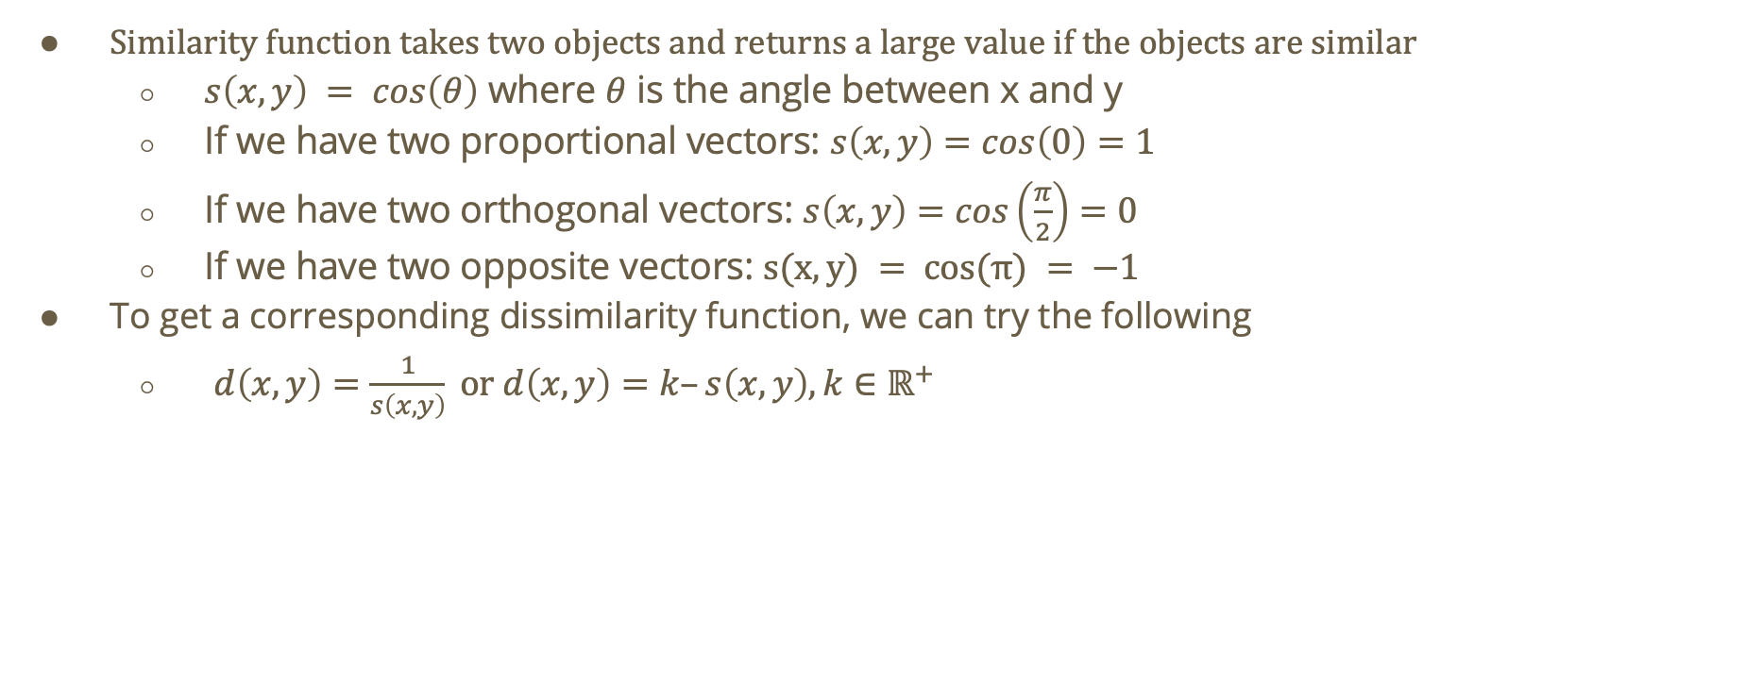
Cosine Similarity
Similarity function takes two objects and returns a large value if the objects are similar
$s\left(x,y\right) = cos\left(θ\right)$ where $θ$ is the angle between x and y
If we have two proportional vectors: $s\left(x,y\right)=cos\left(0\right)=1$
If we have two orthogonal vectors: $s\left(x,y\right)=cos\left(\frac{π}{2}\right)=0$
If we have two opposite vectors: $s(x,y) = cos(π) = −1$
To get a corresponding dissimilarity function, we can try the following
$d\left(x,y\right)=\frac{1}{s\left(x,y\right)} \text{or} d\left(x,y\right)=k–s\left(x,y\right),k∈ℝ^{+}$

Slide 39
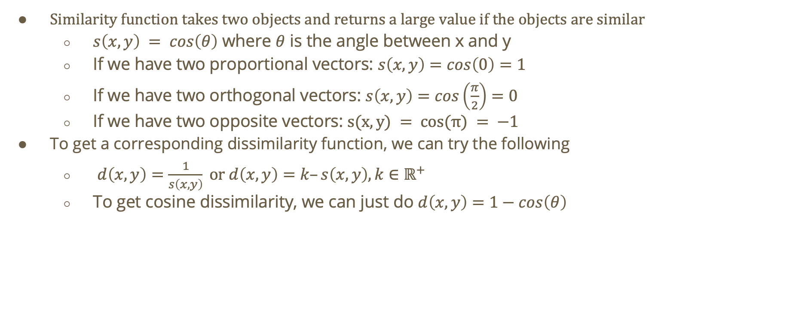
Cosine Similarity
Similarity function takes two objects and returns a large value if the objects are similar
$s\left(x,y\right) = cos\left(θ\right)$ where $θ$ is the angle between x and y
If we have two proportional vectors: $s\left(x,y\right)=cos\left(0\right)=1$
If we have two orthogonal vectors: $s\left(x,y\right)=cos\left(\frac{π}{2}\right)=0$
If we have two opposite vectors: $s(x,y) = cos(π) = −1$
To get a corresponding dissimilarity function, we can try the following
$d\left(x,y\right)=\frac{1}{s\left(x,y\right)} \text{or} d\left(x,y\right)=k–s\left(x,y\right),k∈ℝ^{+}$
To get cosine dissimilarity, we can just do $d\left(x,y\right)=1−cos\left(θ\right)$

Slide 40
Do not edit How to change the design
What is the cosine similarity between A and B?
The Slido app must be installed on every computer you’re presenting from

Slide 41

What is the cosine and Euclidean distance between the following vectors?
Hint: $cos\left(θ\right)=\frac{A⋅B}{\left|A\right|\left|B\right|}$
Based on the results, what does each distance function prioritize?
Cosine distance prioritizes differences in direction
Euclidean distance prioritizes differences in magnitude
A(1,1)
A(1,1)
B(0,1)
B(0,0)

Slide 42
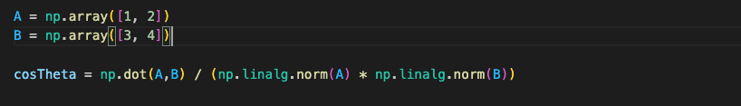
Cosine Similarity and distance using NumPy

